Slide 1
Text format tags

Slide 2
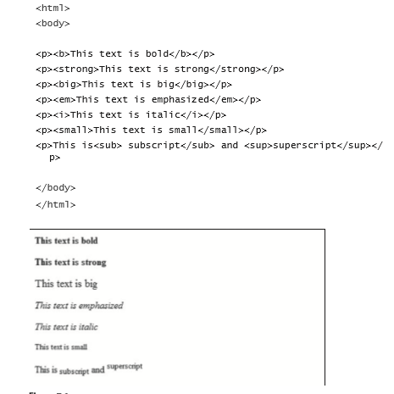
text Formatting

Slide 3

preformatted text
This example demonstrates how you can control the line breaks, spaces, and character widths with the <pre> tag.
<pre>
for i = 1 to 10
print i
next i
</pre>

Slide 4

address
<html> <body>
<address> Donald Duck<br> BOX 555<br> Disneyland<br> USA </address>
</body> </html>

Slide 5

abbreviations and acronyms
<abbr title="United Nations">UN</abbr> <br />
<acronym title="World Wide Web">WWW</acronym>

Slide 6


Quotations
A blockquote quotation: <blockquote> This is a long quotation. This is a long quotation. This is a long quotation. This is a long quotation. This is a long quotation. </blockquote>
A short quotation: <q>This is a short quotation</q>

Slide 7
Deleted and inserted text
Underscore and strikethrough
<p>
a dozen is <del>twenty</del> //twenty
<ins>twelve</ins> pieces //twelve
</p>

Slide 8
Alt Attribute in image

Slide 9
htML Lists
Unordered Lists
Type = A,a,I,i
Ordered Lists
Nested Lists

